Slide 1
Contagion & Interpersonal Influence: Network Models of and for Behavior Change
Social Networks & Health, Duke University
May 18, 2018
Thomas W. Valente, PhD
Professor & Interim Chair
Department of Preventive Medicine
Keck School of Medicine
University of Southern California
tvalente@usc.edu

Slide 2
Outline
Intro
Diffusion of Innovations
Network Models for Diffusion (Network Models of Change)
Network Interventions (Network Models for Change)

Slide 3
Social Networks are Ubiquitous & Varied
Adolescent friendships
Inter-organizational cooperation
Email/phone communications
Trading relations among nations
Workplace advice-seeking
Etc.

Slide 4
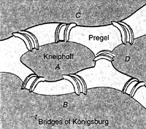
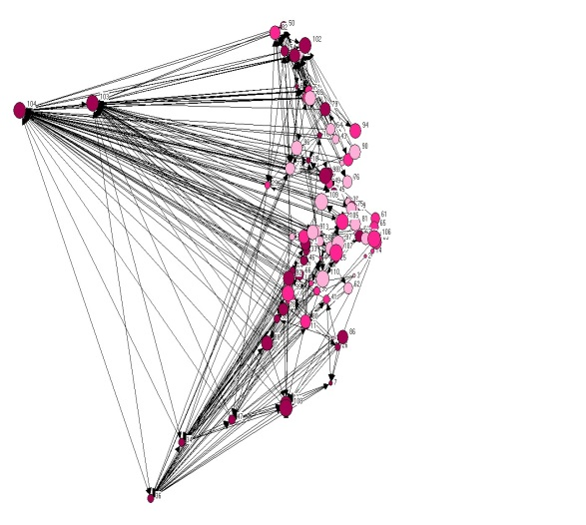
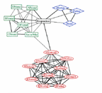
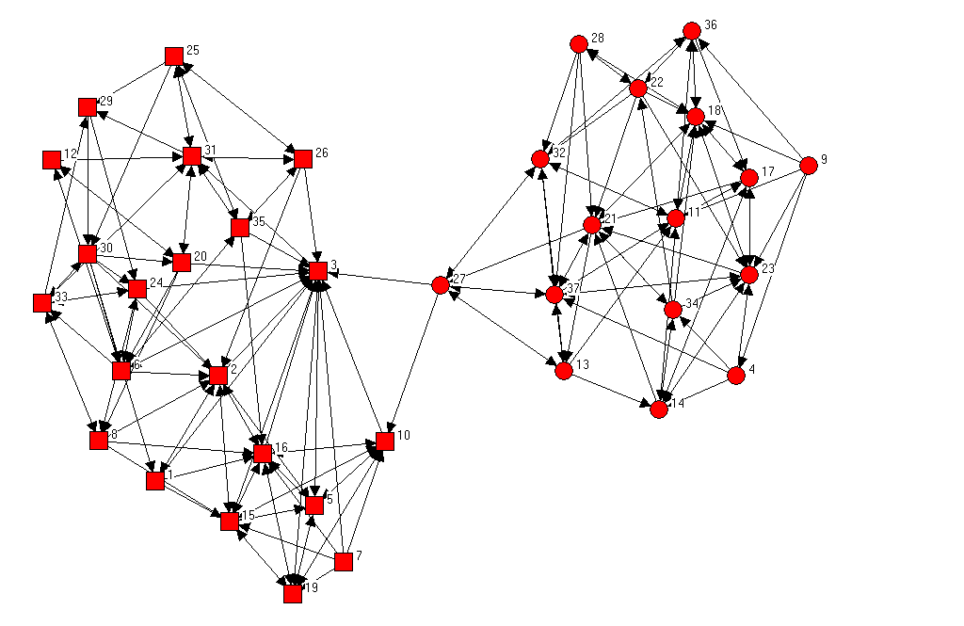
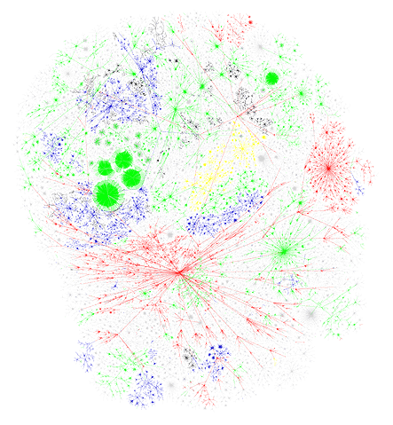
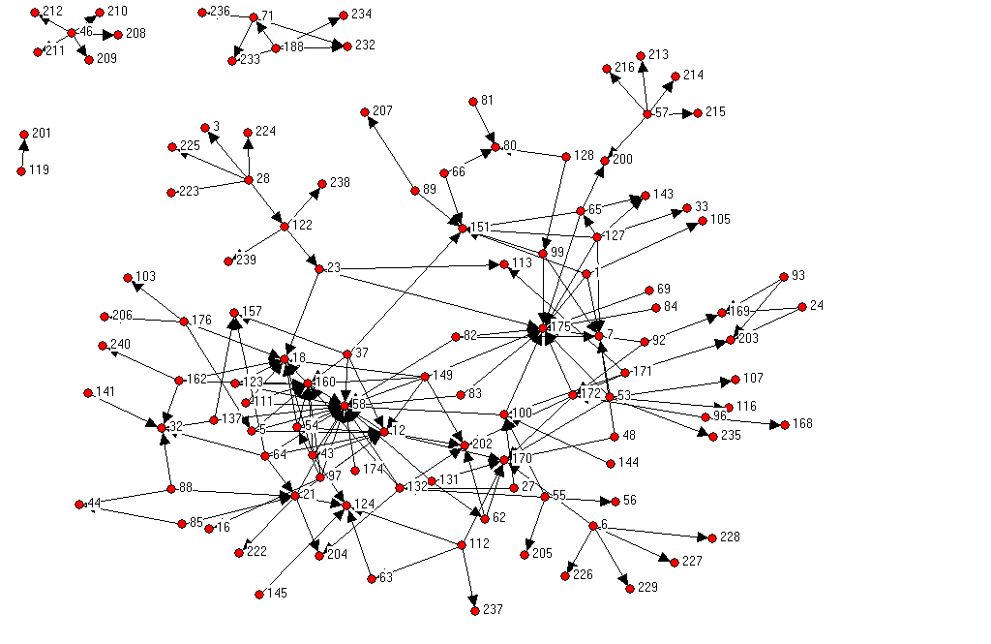
4
Notes:
4

Slide 5
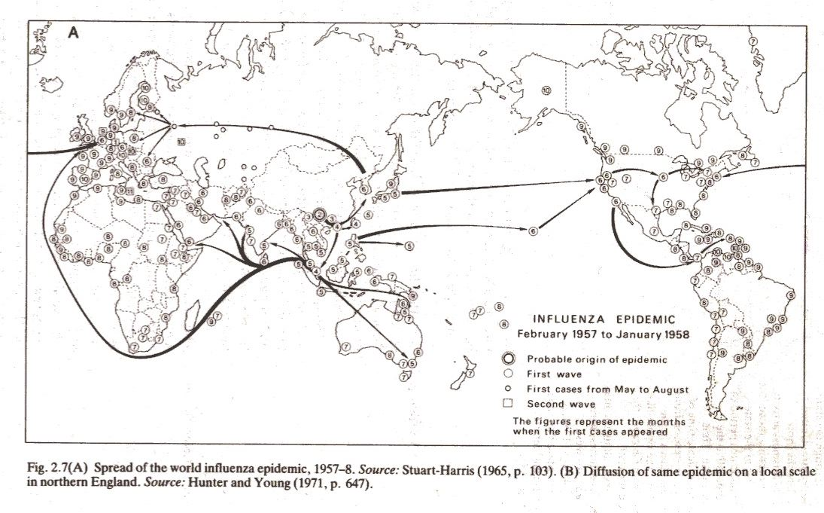
Influenza Pandemic, 1957
Notes:
5
Example of geographical separation – across the globe.
Now diseases can spread much faster with new modes of transportation.
Someone in the U.S. will have 4-7 months to prepare for these pandemics
More recently, SARS epidemic:
China (Guangdong province in Nov 2002) → Hong Kong → Taipei → Singapore → Bankok → Vietnam (Feb 2003) → Manila (March) → Toronto (May)

Slide 6
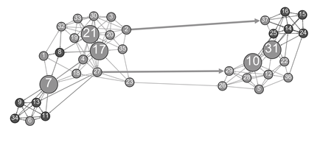
Classroom Friendships Among 12-year Olds

Slide 7
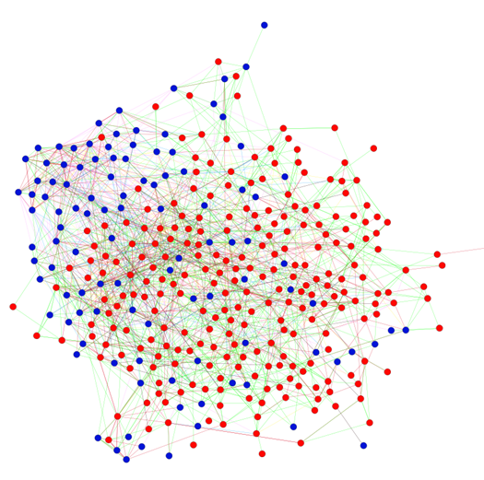
Relationships among 10th graders

Slide 8
2) How do networks influence behavior
Studying networks alone is very interesting
Studying how networks influence behavior moves us from theories about networks to network theory (Borgatti)

Slide 9
Diffusion of Innovations
New ideas and practices originate enter communities from some external source. These external sources can be mass media, labor exchanges, cosmopolitan contact, technical shifts and so on. Adoption of the new idea or practice then flows through interpersonal contact networks.
Notes:
9

Slide 10
Diffusion Occurs Over Time
Notes:
10

Slide 11
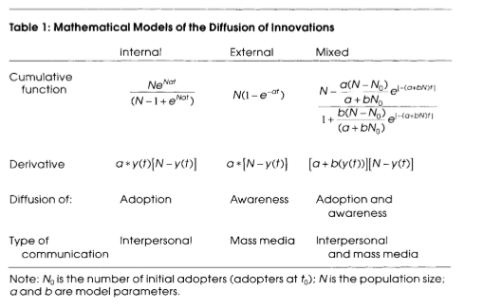
Mathematical Models Used to Derive Diffusion Rate Parameters
Notes:
11
Valente, T. W. (1993). Diffusion of innovations and policy decision-making. Journal of Communication, 43(1), 30-45.

Slide 12
Hypothetical Diffusion When Adopters Persuade Non-adopters at a Rate of One Percent (Homogenous Mixing)
Time | Cum. Ado. | Non Ado. | New Ado. | Cum. Ado.
1 2 3 4 5 6 7 8 9 10 | 0 5 9.75 18.55 33.66 55.99 80.63 96.25 99.86 100 | 100 95 90.25 81.45 66.34 44.01 19.37 3.75 0.14 | 0 4.75 8.8 15.11 22.33 24.64 15.62 3.61 0.14 | 0 9.75 18.55 33.66 55.99 80.63 96.25 99.86 100
Notes:
12

Slide 13
Hypothetical Cumulative and Incidence Adoption Curves for Diffusion Homogenous Mixing
Notes:
13

Slide 14
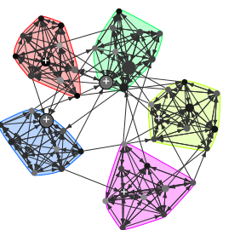
Clustering

Slide 15
Simulated Diffusion Real vs. Random Network
Notes:
Valente, T. W. (In press). Models and methods for innovation diffusion. In P. J. Carrington, J. Scott, & S. Wasserman (Eds.) Models and Methods in Social Network Analysis. Cambridge, UK: Cambridge University Press.

Slide 16
3) Social Network Influences on Behavior (SNA of Behavior Change)
Many models explain how networks influence behavioral decisions/actions
Network exposure model the most common.

Slide 17
Network Exposure
= Non User
= User
Network
Exposure=20%
Network
Exposure=60%
Network
Exposure=80%
Notes:
17
Valente, T.W. (1996). Social network thresholds in the diffusion of innovations. Social Networks, 18, 69-89.

Slide 18
Ego Network with 6 Alters
A
B
F
Ego
C
E
D

Slide 19
Exposure is Associated with Adoption
A
B
F
Ego
C
E
D

Slide 20
Perceived Use is Associated with Use
A
B
F
Ego
C
E
D

Slide 21
Simmelian Ties are Associated with Influence
A
B
F
Ego
C
E
D

Slide 22
Personal Network Environment Increases Influence
A
B
F
Ego
C
E
D

Slide 23
Tie Strength is Associated with Influence
A
B
F
Ego
C
E
D

Slide 24
Weak vs. Strong Ties
Weak ties are important for information spread and rumors
Strong ties are important for behavior change.

Slide 25
Indirect Exposures May Matter
A
B
G
F
Ego
C
H
L
I
E
D
J
K

Slide 26
Structural Equivalence is Associated with Influence
A
D
B
Ego
C

Slide 27
Expanding the Radius of Influence in the Structural Equivalence (SE) Model
The SE matrix represents the most general level of influence. As we raise the matrix to higher powers we shrink the social radius of influence. Thus, SE network exposure can be computed for far (v=1) and near (v>8) individual weighting.

Slide 28
Centrality Weighted Exposures
A
B
F
Ego
C
E
D

Slide 29
Joint Participation / Identification
Events
Events
A
B
1
6
7
2
Ego
8
3
9
4
D
C
10
5

Slide 30
Alter Attributes May Affect Influence
Male
A
B
Female
F
Ego
C
C
E
D

Slide 31

Online vs Offline Network Influences
A
B
F
Ego
C
E
D

Slide 32
Individuals Have Varying Thresholds
Low Threshold Adopter
High Threshold Adopter
A
B
A
B
Ego
Ego
D
C
D
C

Slide 33
Graph of Time of Adoption by Network Threshold for One Korean Family Planning Community
100%
Threshold
0%
Time
1973
1963

Slide 34
Network Influence Weightings
Direct influence
Indirect ties
Structural equivalent ties
Tie strength (e.g., best friends)
Simmelian ties
Density weighted
Degree weighted (or other centrality measures)
Joint participation (e.g., shared teams)
Attribute weighted (e.g., boy friends vs girl friends)
Thresholds

Slide 35
Classic Diffusion Network Studies
 | Medical Innovation | Brazilian Farmers | Korean Family Planning
Country | USA | Brazil | Korean
# Respondents | 125 Doctors | 692 Farmers | 1,047 Women
# Communities | 4 | 11 | 25
Innovation | Tetracycline | Hybrid Corn Seed | Family Planning
Time for Diffusion | 18 Months | 20 Years | 11 Years
Year Data Collected | 1955 | 1966 | 1973
Ave. Time to 50% | 6 | 16 | 7
Highest Saturation | 89 % | 98 % | 83 %
Lowest Saturation | 81 % | 29 % | 44 %
Citation | Coleman et al (1966) | Rogers et al (1970) | Rogers & Kincaid (1981)
35
Notes:
35
Valente, T.W. (1995). Network models of the diffusion of innovations. Cresskill, NJ: Hampton Press

Slide 36
NetdiffuseR
Empirical statistical analysis, visualization, and simulation of diffusion and contagion processes on networks. The package implements algorithms for calculating network diffusion statistics such as transmission rate, hazard rates, exposure models, threshold levels, infectiousness (contagion), and susceptibility, among other features.
The package is inspired by work published in Valente, et al., (2015) DOI:10.1016/j.socscimed.2015.10.001; Valente (1995) ISBN:9781881303213, Myers (2000) DOI:10.1086/303110, Iyengar and others (2011) DOI:10.1287/mksc.1100.0566, Burt (1987) DOI:10.1086/228667; among others.

Slide 37
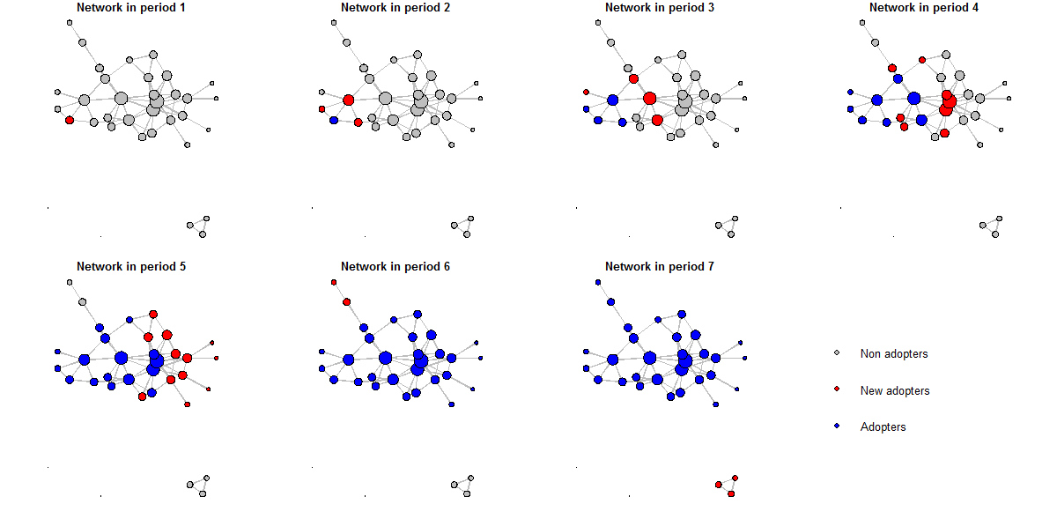
Network Diffusion

Slide 38
Data Limitations in the Classic Studies
Inexact measure of time of adoption
Networks measured one time
Networks are static
Response rates less than 100%
Missing data
Old …

Slide 39
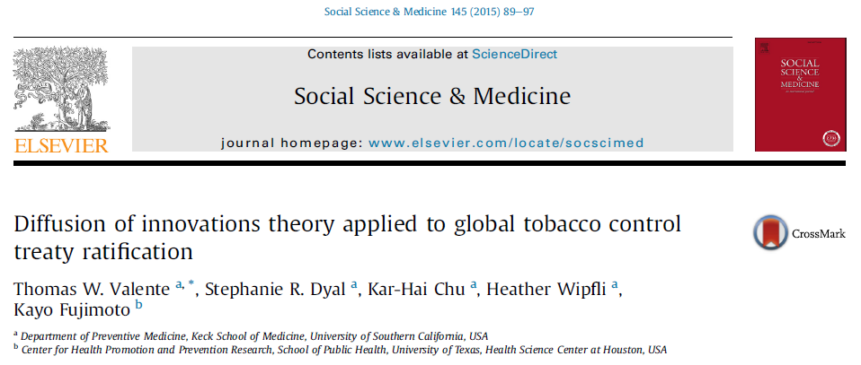

Slide 40
Treaty Ratification Depends on:
Country attributes (population, tobacco production, income, etc.)
Exposure to treaty ratification via networks:
Distance (Recoded as Closeness)
General Trade
Tobacco Trade
GLOBALink Referrals
GLOBALink Posts
GLOBALink Co-Subscriptions

Slide 41
Predictors of FCTC Adoption: Time
 | Adoption (N=754) AORs
Constant | 0.005**
Year
2004 | 13.2**
2005 | 38.5**
2006 | 25.3*
2007 | 13.7
2008 | 19
2009 | 10.1
2010 | 7.88

Slide 42
Predictors of FCTC Adoption: Exposure
 | Adoption (N=754) AORs
Network
Geographic distance | 1.56
General trade | 1.1
Tobacco trade | 0.46
GL referrals - | 0.45
GL posts | 0.51
Subscription co-membership | 4.76**

Slide 43
Dynamic Estimation of Diffusion Effects

Slide 44
Predictors of FCTC Adoption, Threshold, Factors Associated with FCTC Ratification
 | Adoption (N=754) AORs
Time Interacted With:
External Influence - NGOs |  | 0.95 (p=0.12)
Internal Influence - exposure to GL Subscription |  | 0.68 (p=0.02)
Opinion leaders by years 2005 & 2006 |  | 1.01 (p=0.08)
Models included region, population, tobacco production, GDP, political factors,
participation in negotiations, and network in-degree

Slide 45
4) Networks Influences for Behavior Change
If networks are so important, how can we use them to make things better?
Can we use network data to design and implement better interventions?

Slide 46
Many Public Health Interventions Are Network Interventions
They promote seeking healthcare providers
They encourage people to talk about behaviors (e.g., couples who communicate about fertility preferences are more likely to use contraceptives)
They attempt to fragment transmission networks (e.g., clean syringes for IDUs)

Slide 47
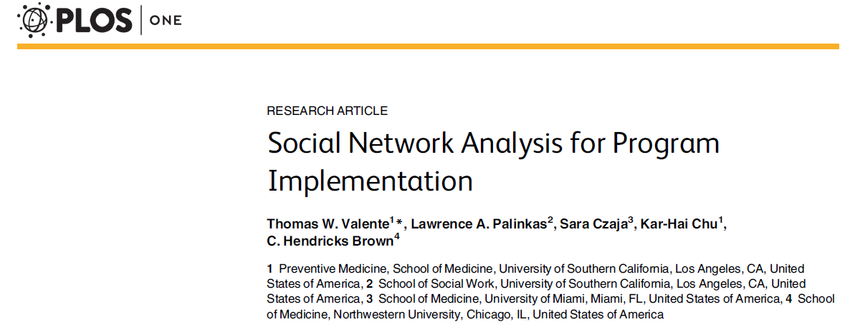
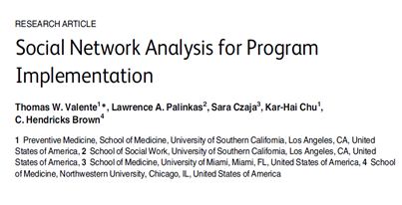
2015

Slide 48
Social Network Analysis for Program Implementation (SNAPI)
 | Stage of Implementation
 | Exploration (Needs Assessment) | Adoption (Program Design) | Implementation | Sustainment & Monitoring
Concept | Network Ethnography | Network Interventions | Network Diagnostics | Network Surveillance
Outcomes | Document network position and structure of those providing input into problem definition. | Select network properties of intervention design. | Use network data to inform and modify intervention delivery. | Ensure continued program use by important network nodes.
Citation |  | Valente, 2012 [22] | Gesell et al., 2013 [70] | Iyengar et al., 2010 [75]

Slide 49
Exploration (Needs Assessment)
Network Ethnography
Is there a network to work with?
What is the network position of those defining the problem?
Are there disconnected subgroups in the community?
Are there isolates who need to be connected?

Slide 50
Who Provides Input for Problem Definition & Program Design?
Program

Slide 51
Community as Network
Makes explicit that problem definition and priority settings will vary depending on who provides input.
Community based organizations are always confident they can hear the voice of the community, but we are all blind to the parts of the network we can’t see.
In this example, people somewhat central in the network are involved but still other segments are left out.

Slide 52
Social Network Analysis for Program Implementation (SNAPI)
 | Stage of Implementation
 | Exploration (Needs Assessment) | Adoption (Program Design) | Implementation | Sustainment & Monitoring
Concept | Network Ethnography | Network Interventions | Network Diagnostics | Network Surveillance
Outcomes | Document network position and structure of those providing input into problem definition. | Select network properties of intervention design. | Use network data to inform and modify intervention delivery. | Ensure continued program use by important network nodes.
Citation |  | Valente, 2012 [22] | Gesell et al., 2013 [70] | Iyengar et al., 2010 [75]

Slide 53
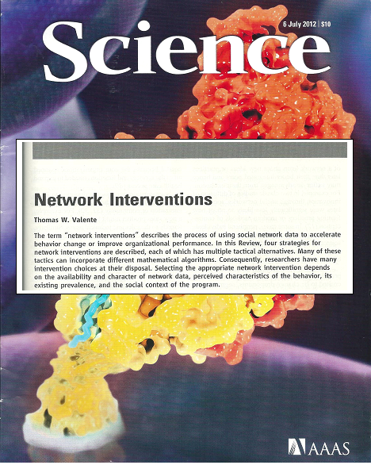

Slide 54
Network Interventions
“Network interventions are purposeful efforts to use social networks or social network data to generate social influence, accelerate behavior change, improve performance, and/or achieve desirable outcomes among individuals, communities, organizations, or populations.”

Slide 55
A Taxonomy of Network Interventions
Strategy | Tactic | Operationalization
Identification | Leaders Bridges Key Players Peripherals Low Thresholds | Degree, Closeness, etc. Mediators, Bridges Positive, Negative Proportions, Counts
Segmentation | Groups Positions | Components, Cliques Structural Equivalence, Hierarchies
Induction | WOM Snowball Matching | Random Excitation RDS, Outreach Leaders 1st, Groups 1st
Alteration (Manipulation) | Deleting/Adding Nodes Deleting/Adding Links Rewiring | Vitality On Cohesion, Others On Network, On Behavior

Slide 56
Opinion Leaders
The most typical network intervention
Easy to measure
Intuitively appealing
Proven effectiveness
Over 20 studies using network data to identify OLs and hundreds of others using other OL identification techniques

Slide 57
Cochrane Review of OL Studies (Flodgren, et al., 2011)
18 trials
5 trials OL vs. No Intervention, +0.09;
2 trials OL vs. 1 Interventions, +0.14;
4 trials OL vs. 2+ Interventions, +0.10; and
10 trials OL+ vs. + Interventions, +0.10.
Overall, the median adjusted RD was +0.12 representing 12% absolute increase in compliance.

Slide 58
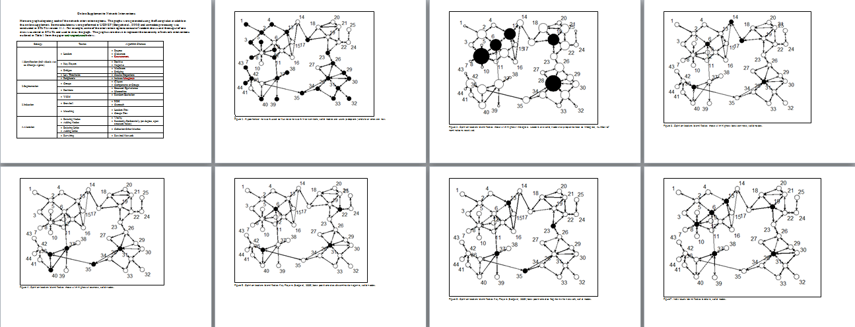
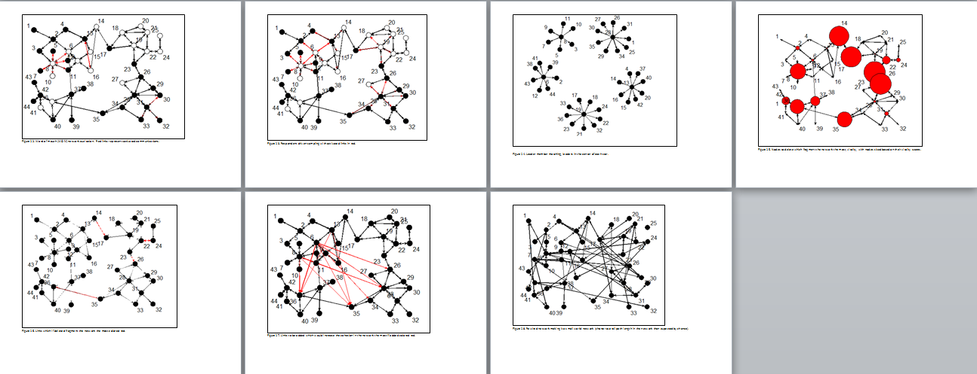
Graphical Displays of Intervention Choices
?

Slide 59
Selecting a Network Intervention
Availability and type of data
Types of networks
Existing network structure
Behavioral characteristics
Existing prevalence
Perceived characteristics such as cultural compatibility; cost; trialability; etc.

Slide 60
Linking Theory to Intervention Strategy
There are several theoretical mechanisms that drive contagion and/or behavior change.
Evidence for a particular mechanism suggests choice of intervention strategy or tactic.

Slide 61
Influence Mechanisms Aligned with Interv. Choices
Mechanism | Tactic
Power Conflict Cohesion Isolation Thresholds | Leaders Bridges Key Players Peripherals Low Thresholds
Group Identification Structural Equivalence | Groups Positions
Information diffusion Hard to reach populations Closure Homophily | WOM Snowball Outreach Matching
Attributes Structure Structure!! | Deleting/Adding Nodes Deleting/Adding Links Rewiring

Slide 62
Social Network Analysis for Program Implementation (SNAPI)
 | Stage of Implementation
 | Exploration (Needs Assessment) | Adoption (Program Design) | Implementation | Sustainment & Monitoring
Concept | Network Ethnography | Network Interventions | Network Diagnostics | Network Surveillance
Outcomes | Document network position and structure of those providing input into problem definition. | Select network properties of intervention design. | Use network data to inform and modify intervention delivery. | Ensure continued program use by important network nodes.
Citation |  | Valente, 2012 [22] | Gesell et al., 2013 [70] | Iyengar et al., 2010 [75]

Slide 63
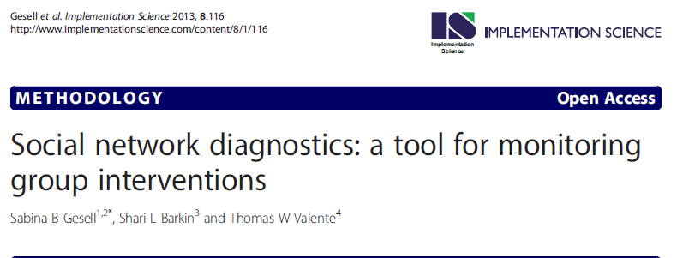
Network Diagnostics

Slide 64
Network Diagnostics Tool
Metric | Threshold | Examples of teaching methods thought to improve network structure
Isolates | Value should be equal to 0 | Give each participant the opportunity to be part of the conversation.
Degree | Value should be greater than 1 | Pair highly connected group members with others in small group activities in session.
Reciprocity | Values should be >0.50 | Interventionist to pair non-reciprocated links: If A sends a tie to B, but B does not send a tie to A, then Interventionist will pair A and B in small group activities in session.
Components | Value should be equal to 0 | Create bridges: Pair members from different subgroups in small group activities in session.
Density | Value should be >0.15 but <0.50 | Begin each session with an interactive, personalized, community-building ice breaker.
Centralization | Values should be <0.25 | Avoid pairing central nodes with isolates.
Transitivity | Values should be >0.3 | Bring triads together for activities. If A is friends with B and C, connect B and C.
Cohesion | Values should be <0.50 (±.25) | Challenges group to make and meet a shared common goal (e.g., weekly wellness challenge: 15 minutes of walking per day).
Notes:
The manner in which diagnostics estimates trigger particular teaching recommendations is quite flexible. To illustrate, observed low degree might prompt recommendations that are (1) data-specific (e.g., “pair Betty with Mary in the next small group activity”), or (2) general (e.g., “begin the next session with an ice-breaker activity to get all participants involved”). We feel, however, that it is important to specify the thresholds and branching logic (if measure x is low, then recommend a, b, and c) in advance, so that the tool can be consistently implemented across multiple groups over a long trial period.

Slide 65
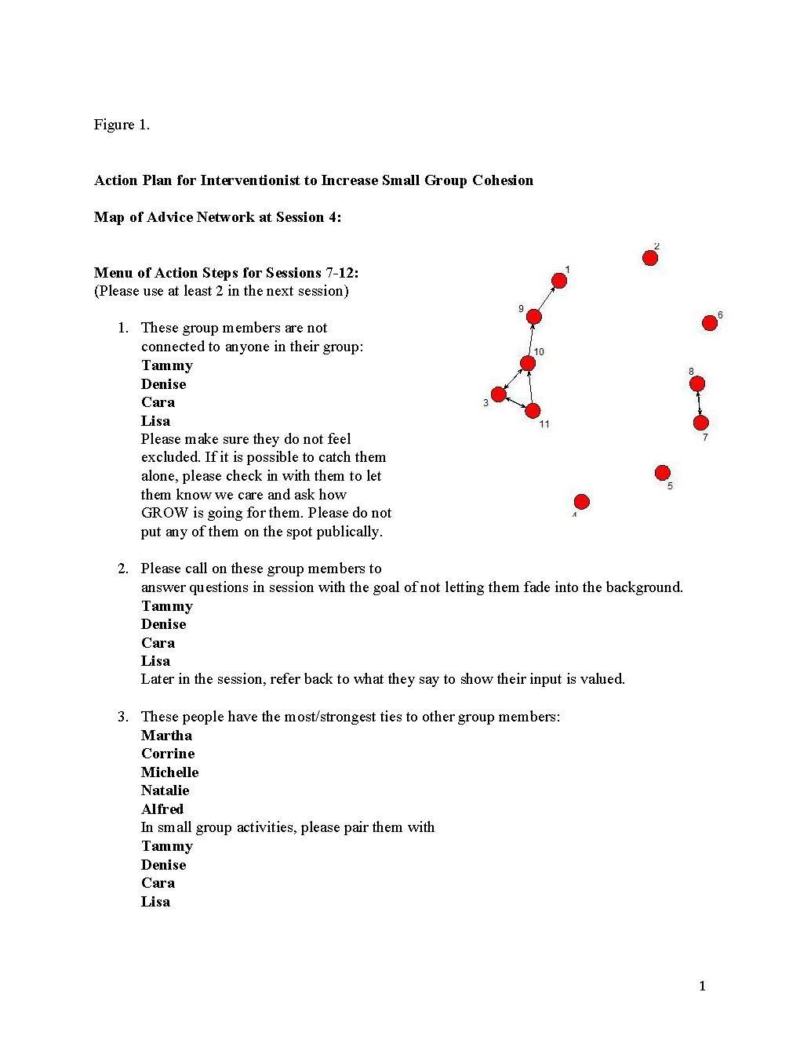
Action Report for Group Leader
Notes:
To provide a cogent illustration, we included only the action report based on the advice network here. The group leader received action items based on the discussion network as well.

Slide 66
Networks as Mediators and/or Moderators
Initial evidence suggests that program effectiveness depends on individual- and network-level characteristics.
Moderators: Program works for people without users in the network (low threshold adopters for example)
Mediators: Program designed to increase social support seeking.

Slide 67
Moderators & Mediators
Moderation
Network
Exposure
Effect
Mediation
Exposure
Network
Effect

Slide 68
Conclusions
Social network theory and analysis has been around for decades.
The field is expanding rapidly today due to the many applications in all areas of science.

Slide 69
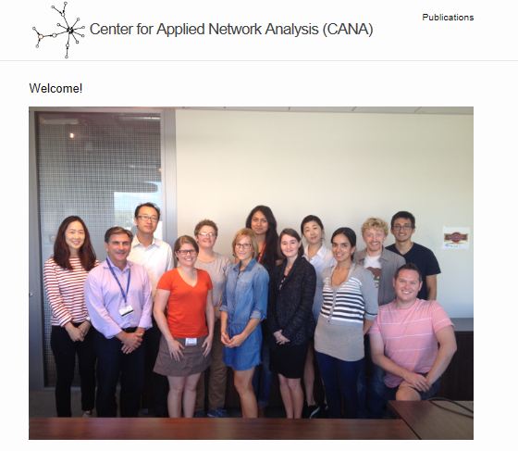
Thanks to my Colleagues & Friends!

Slide 70
Thank You

